Slide 1

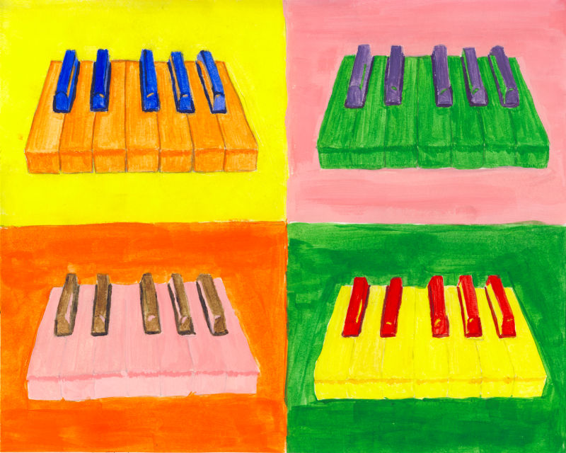
OCR GCSE Music Terminology Introductory Booklet
Name: ____________________
Teacher:___________________

Slide 2
Contents Page
Contents…..…………………………………………………………………….2
Icons……………………………………………………………………………….3
Overview………………………………………………………………………..4
Elements of Music for Listening Skills Development and Core Knowledge 100% Sheets…………..……………………….5-16
Glossary…………………………………………………………………..17-26
Notes……………………………………………………………………….27-30
Additional Space……………………………………………………..31-34

Slide 3







Icons
Activating prior knowledge
Remember what you already know about a topic before you start to learn something new, to help build connections in your long-term memory.
Retrieval practice
Quizzing, recall and memory activities to slow down the rate of forgetting!
New knowledge
Learn something new through reading, teacher explanation, diagrams, listening to or watching something.
Processing knowledge
Do something with your new knowledge to help you understand it better.
Guided practice
Work collaboratively with your teacher as you strengthen new skills.
Independent practice
Using your knowledge and understanding to complete a piece of quality work independently.
Reflect and respond
Thinking about what you have learned, what went well and what you could improve next time.

Slide 4
Topic Overview: Introduction to Key Information and Terminology in GCSE Music
What is this topic about?
The information in this booklet will give you full support during your initial learning of new knowledge and key terms, as well as recapping past knowledge on the basic musical features and terminology vital to success in GCSE music.
Link to the GCSE Assessment:
This knowledge of key features and Terminology is engrained in the entirety of the course and so must be learned and retained for each Area of Study, when composing and when sitting the listening exam in Y11.
How will you be assessed in this topic?
You will be assessed with an initial baseline test to test your current musical skills/knowledge. You will then be formatively assessed on individual critical listening, performance and composition tasks designed to use specific musical features in your current learning to assess comprehension during the continuous progression. You will also be assessed with summative tests involving exam style questions, listening questions, terminology questions and musical analysis.

Slide 5
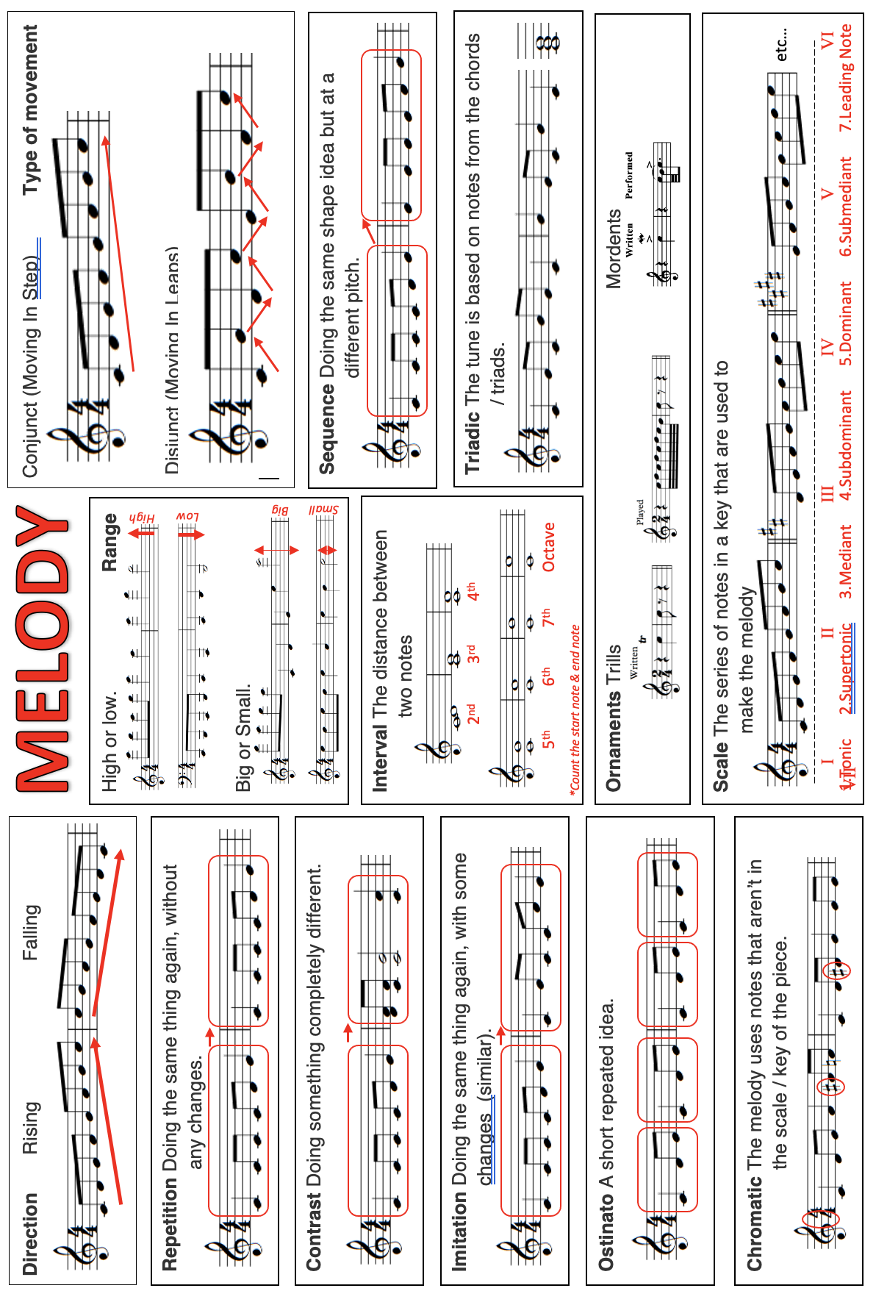

Slide 13
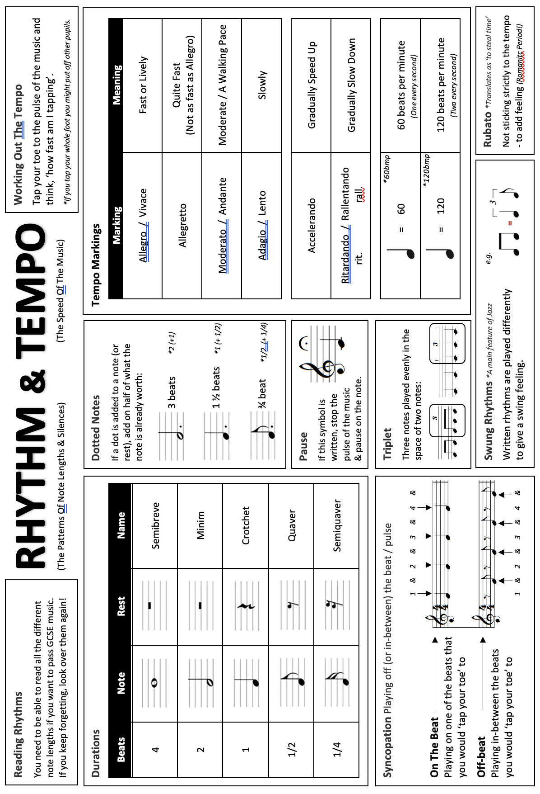

Slide 16
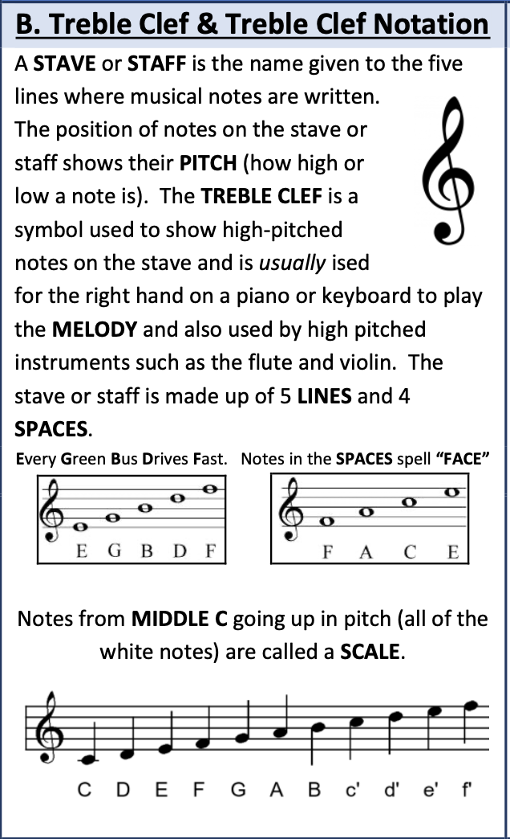
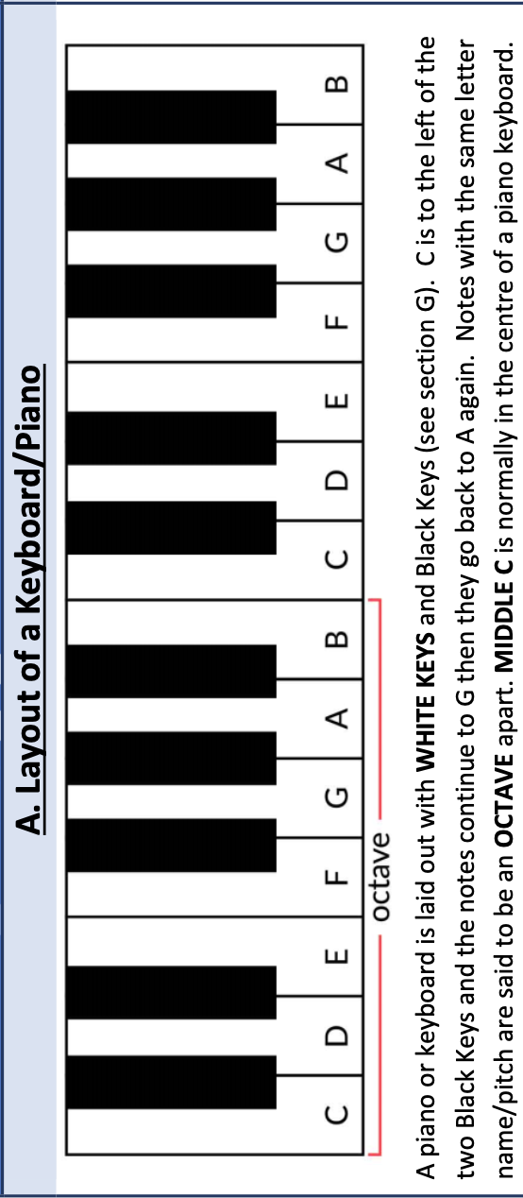
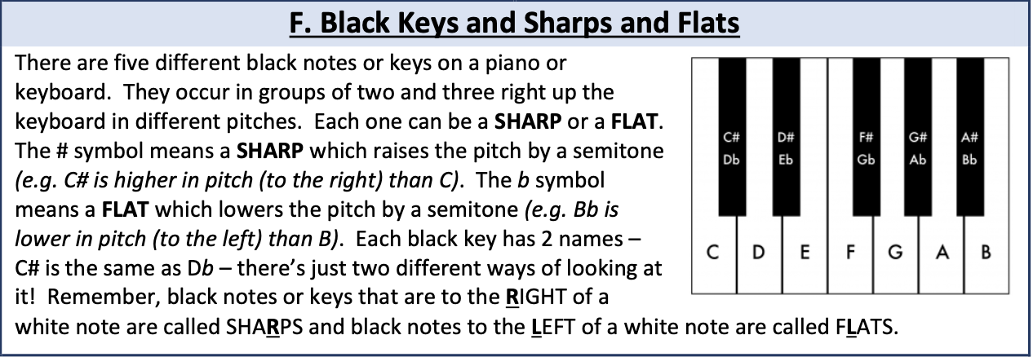
Keyboard and Notation

Slide 17
Glossary

Slide 31
Additional Space
……………………………………………………………………………………………………………………………............................
……………………………………………………………………………………………………………………………………………………….
……………………………………………………………………………………………………………………………............................
……………………………………………………………………………………………………………………………………………………….
……………………………………………………………………………………………………………………………............................
……………………………………………………………………………………………………………………………………………………….
……………………………………………………………………………………………………………………………............................
……………………………………………………………………………………………………………………………………………………….
……………………………………………………………………………………………………………………………............................
……………………………………………………………………………………………………………………………………………………….
……………………………………………………………………………………………………………………………............................
……………………………………………………………………………………………………………………………………………………….
……………………………………………………………………………………………………………………………............................
……………………………………………………………………………………………………………………………………………………….
……………………………………………………………………………………………………………………………............................
……………………………………………………………………………………………………………………………………………………….
……………………………………………………………………………………………………………………………............................
……………………………………………………………………………………………………………………………………………………….
……………………………………………………………………………………………………………………………............................
……………………………………………………………………………………………………………………………………………………….

Slide 32
……………………………………………………………………………………………………………………………............................
……………………………………………………………………………………………………………………………………………………….
……………………………………………………………………………………………………………………………............................
……………………………………………………………………………………………………………………………………………………….
……………………………………………………………………………………………………………………………............................
……………………………………………………………………………………………………………………………………………………….
……………………………………………………………………………………………………………………………............................
……………………………………………………………………………………………………………………………………………………….
……………………………………………………………………………………………………………………………............................
……………………………………………………………………………………………………………………………………………………….
……………………………………………………………………………………………………………………………............................
……………………………………………………………………………………………………………………………………………………….
……………………………………………………………………………………………………………………………............................
……………………………………………………………………………………………………………………………………………………….
……………………………………………………………………………………………………………………………............................
……………………………………………………………………………………………………………………………………………………….
……………………………………………………………………………………………………………………………............................
……………………………………………………………………………………………………………………………………………………….
……………………………………………………………………………………………………………………………............................
……………………………………………………………………………………………………………………………………………………….

Slide 33
……………………………………………………………………………………………………………………………............................
……………………………………………………………………………………………………………………………………………………….
……………………………………………………………………………………………………………………………............................
……………………………………………………………………………………………………………………………………………………….
……………………………………………………………………………………………………………………………............................
……………………………………………………………………………………………………………………………………………………….
……………………………………………………………………………………………………………………………............................
……………………………………………………………………………………………………………………………………………………….
……………………………………………………………………………………………………………………………............................
……………………………………………………………………………………………………………………………………………………….
……………………………………………………………………………………………………………………………............................
……………………………………………………………………………………………………………………………………………………….
……………………………………………………………………………………………………………………………............................
……………………………………………………………………………………………………………………………………………………….
……………………………………………………………………………………………………………………………............................
……………………………………………………………………………………………………………………………………………………….
……………………………………………………………………………………………………………………………............................
……………………………………………………………………………………………………………………………………………………….
……………………………………………………………………………………………………………………………............................
……………………………………………………………………………………………………………………………………………………….

Slide 34
……………………………………………………………………………………………………………………………............................
……………………………………………………………………………………………………………………………………………………….
……………………………………………………………………………………………………………………………............................
……………………………………………………………………………………………………………………………………………………….
……………………………………………………………………………………………………………………………............................
……………………………………………………………………………………………………………………………………………………….
……………………………………………………………………………………………………………………………............................
……………………………………………………………………………………………………………………………………………………….
……………………………………………………………………………………………………………………………............................
……………………………………………………………………………………………………………………………………………………….
……………………………………………………………………………………………………………………………............................
……………………………………………………………………………………………………………………………………………………….
……………………………………………………………………………………………………………………………............................
……………………………………………………………………………………………………………………………………………………….
……………………………………………………………………………………………………………………………............................
……………………………………………………………………………………………………………………………………………………….
……………………………………………………………………………………………………………………………............................
……………………………………………………………………………………………………………………………………………………….
……………………………………………………………………………………………………………………………............................
……………………………………………………………………………………………………………………………………………………….

