Slide 1
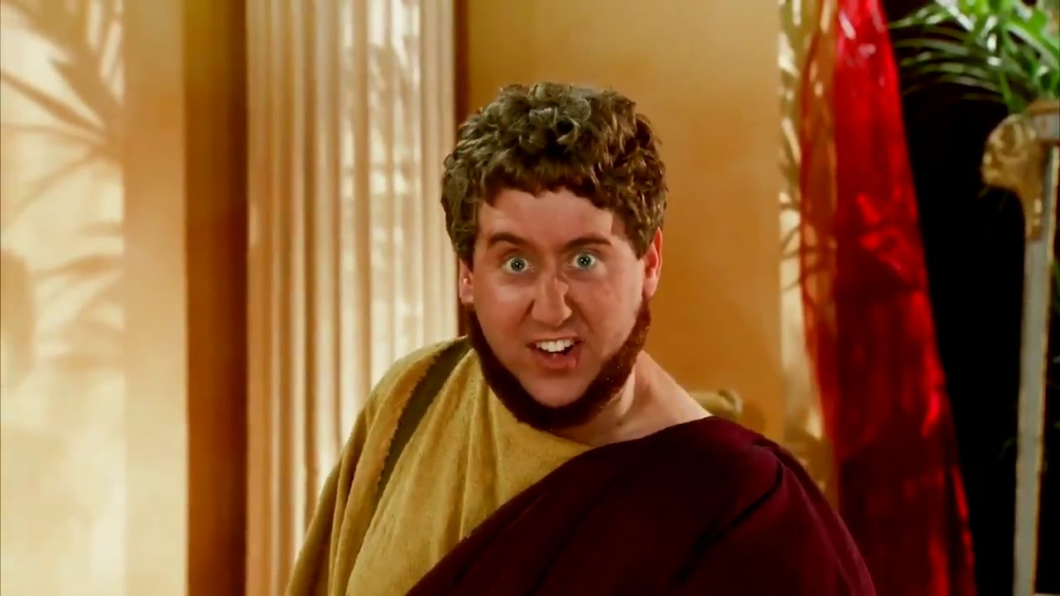
Y9 Music for Advertisements
Name: ____________________
Teacher:___________________
Hi! I’m A Shouty Man

Slide 2
Contents Page
Contents…..…………………………………………………………………….2
100% Sheet…………………………………………………………………….3
Icons……………………………………………………………………………….4
Overview………………………………………………………………………..5
Glossary………………………………………………………………………….6
Guided Activities……………………………………………………………………7-10
Retrieval Activities……………………………………………........11-13
Project Pages…………………………………………………………..14-18
Homework……………………………………………………………….19-20
Whole Class Feedback…………………………………………….......21
Additional Space……………………………………………………..22-24

Slide 3
Music Music For Advertisements 100% Sheet
Key words
Ident | A short musical phrase for the purpose of advertising or being in association with a product/company/event.
Jingle | A short musical phrase with a sung slogan for the purposes of advertisement.
Advertisement | A medium in which a product, company or other commercial event or object is promoted to the general public.
Incidental Music/Underscore | Music played in the background to create or enhance a particular atmosphere.
Original Songs | Songs that are composed/written for a new or specific purpose.
Borrowed music | When a song or piece of music is used for a different purpose than it was originally created for
Instrumental music | Music that contains no lyrics
Why is music in Advertisements important?
Music can affect audience emotions and make your ad memorable.
Used wisely, brave and bold choices can help you differentiate, re-brand and set your advertising apart from the crowd.
Key Features of Advertisements
Eye catching
Short
Simple
Contain facts about the product/company/event
Catchy music, slogan
Memorable characters/mascots
Appeal to target audience

Slide 4
Icons
Activating prior knowledge
Remember what you already know about a topic before you start to learn something new, to help build connections in your long-term memory.
Retrieval practice
Quizzing, recall and memory activities to slow down the rate of forgetting!
New knowledge
Learn something new through reading, teacher explanation, diagrams, listening to or watching something.
Processing knowledge
Do something with your new knowledge to help you understand it better.
Guided practice
Work collaboratively with your teacher as you strengthen new skills.
Independent practice
Using your knowledge and understanding to complete a piece of quality work independently.
Reflect and respond
Thinking about what you have learned, what went well and what you could improve next time.

Slide 5
Topic Overview: Music for Advertisements
What is this topic about?
This topic explores the importance and effectiveness of incidental music and it’s role in advertisements. Students will learn how to identify key advertisement techniques, with focus on how music is used in the medium.
Link to the GCSE:
The Music for advertisements topic introduces/reintroduces them to the musical features such as themes, music that evokes emotion and therefore will benefit them for GCSE when studying Film music, Pop music, when composing. As well as support their continuous training in critical listening and musical analysis.
Why is this topic important?
Advertisement is a large and continuously prosperous industry and so having the knowledge that this topic provides, especially when it comes to using music to manipulate/encourage emotions, will give key support when entering this industry.
How will you be assessed in this topic?
Students will be assessed on how they work in a team, how they plan work before undertaking the main project and the finished product, plan and musical compositions.

Slide 6
Glossary
Word | Definition
Ident | A short musical phrase for the purpose of advertising or being in association with a product/company/event.
Jingle | A short musical phrase with a sung slogan for the purposes of advertisement.
Advertisement | A medium in which a product, company or other commercial event or object is promoted to the general public.
Incidental Music/Underscore | Music played in the background to create or enhance a particular atmosphere.
Original Songs | Songs that are composed/written for a new or specific purpose.
Borrowed music | When a song or piece of music is used for a different purpose than it was originally created for
Instrumental music | Music that contains no lyrics

Slide 7
Do It Now:
What is an Advert?
__________________________
______________________________________________________________________________
What are the features
of an Advert?
__________________________
____________________________________________________________________________________________________________________________________________________________

Slide 8
Do It Now: What product do these slogans belong to?
1) They’rrrrrrre Great!!
2) Finger Lickin’ Good
3) Taste The Rainbow
4) Gives You Wings
5) The Happiest Place On Earth
6) Every Little Helps
7) Because You’re Worth It
8) Eat Fresh!

Slide 9
Do It Now: Recall what an Ident and Jingle are?
__________________________
____________________________________________________________________________________________________________________________________________________________
Ident
__________________________
____________________________________________________________________________________________________________________________________________________________
Jingle

Slide 10
Do It Now: Recall what is meant by borrowed music and original music?
__________________________
____________________________________________________________________________________________________________________________________________________________
Borrowed
__________________________
____________________________________________________________________________________________________________________________________________________________
Original

Slide 11
Do Now: Brain Dump all the Key features of an Advert you can remember and define them

Slide 12
Do Now: Brain Dump all the Key features of the music in adverts

Slide 13
Do Now: Brain Dump all the different types of music used in adverts

Slide 14
Creating Your Advert Checklist
Job Allocation for Product Design
Job | Group Member/s
Writing the Voice Over for advert
Designing/Drawing the product and Labelling
Product details
Jingle/underscore
To Do | Tick when completed
Choose a product (original)
Discuss product style, function, target market, image, price etc…
Design Product
Create ‘JINGLE’ for end of advert.
Create ‘UNDERSCORE’ for rest of advert
Write ‘VOICE-OVER’
Put all ingredients together and Practice

Slide 15
Initial Planning
Hi! I’m A Shouty Man
Use the checklist to help you plan
Space for Planning

Slide 16
Our Product Plan…
Hi! I’m A Shouty Man
What is it?
What does it do?
Name of product
Special Features
Size
Colour
Where can you buy it
Cost of product

Slide 17
VOICE-OVER
Hi! I’m A Shouty Man
Must contain relevant information and be spoken / sung clearly.
Product name/Price/What it does/Where to buy it/Any special offers?
Space to write your Script for your Voice-Over
___________________________________
____________________________________________________________________________________________________________________________________________________________________________________________________________________________________________________________________________________________________________________________________________________________________________________________________________________________________

Slide 18
Jingle and Underscore
Hi! I’m A Shouty Man
Your jingle is what sells your product. It must be simple catchy.
1) Use only a few different notes 2) Keep it short 3) Use a timbre (voice) appropriate to your target market 4)Create a rhyming slogan.
Space to write your ideas down for your jingle and underscore

Slide 19
Homework: Research a current advert and answer the questions below
What is it selling?
What type of music does it use?
Does it have an ident/jingle?
Is the advert effective? And why? or why not?
Does the music work with the product? And why? or why not?

Slide 20
Homework: choose a current advert on TV that you don’t like…
Explain why you don’t like it
Then, make a plan of how you would make it better; think about:
Target audience
Song/music choice
Actors
Setting/scene
Words/script

Slide 21
Whole class feedback response:
What Went Well………
I know this because ……..
Even Better If……..
I will do this by ………
The benefit to me of this would be …….

Slide 22
Additional Space
……………………………………………………………………………………………………………………………............................
……………………………………………………………………………………………………………………………………………………….
……………………………………………………………………………………………………………………………............................
……………………………………………………………………………………………………………………………………………………….
……………………………………………………………………………………………………………………………............................
……………………………………………………………………………………………………………………………………………………….
……………………………………………………………………………………………………………………………............................
……………………………………………………………………………………………………………………………………………………….
……………………………………………………………………………………………………………………………............................
……………………………………………………………………………………………………………………………………………………….
……………………………………………………………………………………………………………………………............................
……………………………………………………………………………………………………………………………………………………….
……………………………………………………………………………………………………………………………............................
……………………………………………………………………………………………………………………………………………………….
……………………………………………………………………………………………………………………………............................
……………………………………………………………………………………………………………………………………………………….
……………………………………………………………………………………………………………………………............................
……………………………………………………………………………………………………………………………………………………….
……………………………………………………………………………………………………………………………............................
……………………………………………………………………………………………………………………………………………………….

Slide 23
Additional Space
……………………………………………………………………………………………………………………………............................
……………………………………………………………………………………………………………………………………………………….
……………………………………………………………………………………………………………………………............................
……………………………………………………………………………………………………………………………………………………….
……………………………………………………………………………………………………………………………............................
……………………………………………………………………………………………………………………………………………………….
……………………………………………………………………………………………………………………………............................
……………………………………………………………………………………………………………………………………………………….
……………………………………………………………………………………………………………………………............................
……………………………………………………………………………………………………………………………………………………….
……………………………………………………………………………………………………………………………............................
……………………………………………………………………………………………………………………………………………………….
……………………………………………………………………………………………………………………………............................
……………………………………………………………………………………………………………………………………………………….
……………………………………………………………………………………………………………………………............................
……………………………………………………………………………………………………………………………………………………….
……………………………………………………………………………………………………………………………............................
……………………………………………………………………………………………………………………………………………………….
……………………………………………………………………………………………………………………………............................
……………………………………………………………………………………………………………………………………………………….

Slide 24
……………………………………………………………………………………………………………………………............................
……………………………………………………………………………………………………………………………………………………….
……………………………………………………………………………………………………………………………............................
……………………………………………………………………………………………………………………………………………………….
……………………………………………………………………………………………………………………………............................
……………………………………………………………………………………………………………………………………………………….
……………………………………………………………………………………………………………………………............................
……………………………………………………………………………………………………………………………………………………….
……………………………………………………………………………………………………………………………............................
……………………………………………………………………………………………………………………………………………………….
……………………………………………………………………………………………………………………………............................
……………………………………………………………………………………………………………………………………………………….
……………………………………………………………………………………………………………………………............................
……………………………………………………………………………………………………………………………………………………….
……………………………………………………………………………………………………………………………............................
……………………………………………………………………………………………………………………………………………………….
……………………………………………………………………………………………………………………………............................
……………………………………………………………………………………………………………………………………………………….
……………………………………………………………………………………………………………………………............................
……………………………………………………………………………………………………………………………………………………….

Slide 25
……………………………………………………………………………………………………………………………............................
……………………………………………………………………………………………………………………………………………………….
……………………………………………………………………………………………………………………………............................
……………………………………………………………………………………………………………………………………………………….
……………………………………………………………………………………………………………………………............................
……………………………………………………………………………………………………………………………………………………….
……………………………………………………………………………………………………………………………............................
……………………………………………………………………………………………………………………………………………………….
……………………………………………………………………………………………………………………………............................
……………………………………………………………………………………………………………………………………………………….
……………………………………………………………………………………………………………………………............................
……………………………………………………………………………………………………………………………………………………….
……………………………………………………………………………………………………………………………............................
……………………………………………………………………………………………………………………………………………………….
……………………………………………………………………………………………………………………………............................
……………………………………………………………………………………………………………………………………………………….
……………………………………………………………………………………………………………………………............................
……………………………………………………………………………………………………………………………………………………….
……………………………………………………………………………………………………………………………............................
……………………………………………………………………………………………………………………………………………………….

