Slide 1
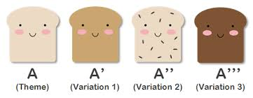
Y8 Theme and Variation
Name: ____________________
Teacher:___________________

Slide 2
Contents Page
Contents…..…………………………………………………………………….2
100% Sheet…………………………………………………………………….3
Icons……………………………………………………………………………….4
Overview………………………………………………………………………..5
Glossary………………………………………………………………………….6
Elements of Music Overview…………………………………………..7
Retrieval Activities……………………………………………………………………8-13
Homework Activities…………………………………………………….14
Whole Class Feedback………………………………………………….15
Appendix A…………………………………………………………………..16
Additional Space……………………………………………………..17-20

Slide 3
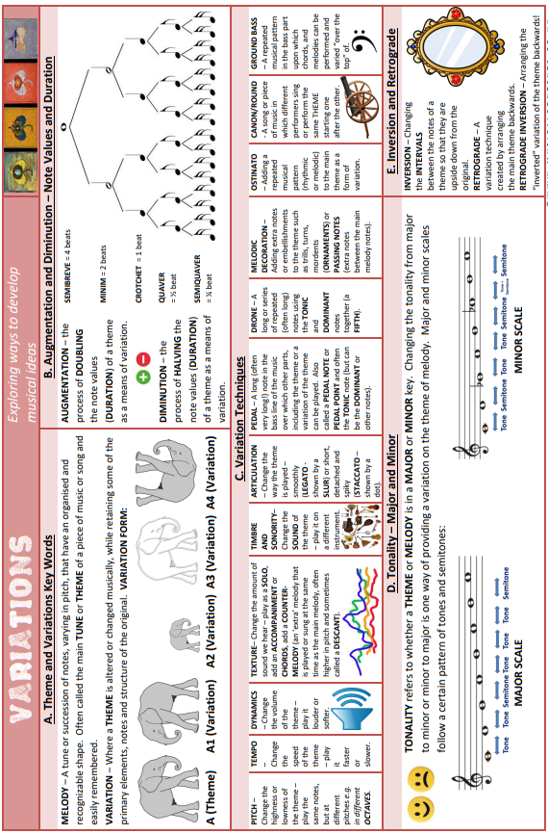
100% Sheet

Slide 4
Icons
Activating prior knowledge
Remember what you already know about a topic before you start to learn something new, to help build connections in your long-term memory.
Retrieval practice
Quizzing, recall and memory activities to slow down the rate of forgetting!
New knowledge
Learn something new through reading, teacher explanation, diagrams, listening to or watching something.
Processing knowledge
Do something with your new knowledge to help you understand it better.
Guided practice
Work collaboratively with your teacher as you strengthen new skills.
Independent practice
Using your knowledge and understanding to complete a piece of quality work independently.
Reflect and respond
Thinking about what you have learned, what went well and what you could improve next time.

Slide 5
Topic Overview: The Elements of Music
What is this topic about?
This topic is designed to introduce students to the topic of themes and strategies to develop these musical ideas.
You will study a short piece of familiar music then, over the weeks, learn to alter and develop the music using melodic variations.
Link to the GCSE:
During GCSE students will compose two pieces of music which will require using these compositional techniques to ensure that enough variation, skill level and originality is shown in your work.
Why is this topic important?
To develop a composition is a vital skill for a composer as it allows one to explore original ideas past the basics of composition required for professional practice.
It gives the person a working knowledge on compositional processes, which will provide insight into all manner of creative avenues in all walks of life.
How will you be assessed in this topic?
You will be assessed with formative assessment points throughout your composition. You will also be assessed with a summative final performance.

Slide 6
Glossary
Word | A collection of ordered pitched sounds
Melody | A collection of ordered pitched sounds
Articulation | The various ways you can play a note e.g. smoothly, sharply
Dynamics | The volume of the sound
Tempo | The speed of the music
Inversion | Playing the melody upside down or backwards
Pedal/Drone | A repeated/held note on a fixed pitch
Augmentation (augment) | To lengthen the rhythmic value by double the original value
Diminution (diminish) | To shorten the rhythmic value by half of the original value
Rhythm | A pattern of sound of different lengths
Pitch | How high or low a sound is perceived
Duration | The length of a note
Variation | An altered version of an original musical idea
Ornament | Decorating notes with various notation and musical techniques

Slide 7
E
L
O
D
Y
R
T
I
C
U
L
A
T
I
O
N
Y
N
A
M
I
C
S
E
M
P
O
T
R
U
C
T
U
R
E
A
R
M
O
N
Y
&
T
O
N
A
L
I
T
Y
N
S
T
R
U
M
E
N
T
S
&
T
I
M
B
R
E
H
Y
T
H
M
&
M
E
T
R
E
E
X
T
U
R
E

Slide 8
Do Now: Brain Dump all the ways to vary a melody you can remember and define them
Variations

Slide 9
Do Now: Brain Dump all the ways to vary a melody you can remember and define them
Variations

Slide 10
Do Now: Test your knowledge on variations and elements of music
What’s the term for when you play a melody backwards as a variation?
_____________________________
2) What is a drone?
_____________________________
3) What does ‘Tempo’ mean?
_____________________________
4) What are Dynamics?
_____________________________

Slide 11
Do Now: Test your knowledge on variations and elements of music
Give one way you could change the dynamics for a variation?
_____________________________
2) What is a pedal?
_____________________________
3) What does ‘Melody’ mean?
_____________________________
4) What are ‘ornaments’ in music?
_____________________________

Slide 12
Do Now: Brain Dump all you can remember about theme and variation and define each term
Theme and Variations

Slide 13
Do Now: Draw a picture in the colour coded boxes to represent the different Elements of music that start with each colour coded letter of MAD TSHIRT
THE ELEMENTS OF MUSIC

Slide 14
Homework: create a fact file/poster on the different variation techniques you can change a theme by
Stick Fact File here

Slide 15
Whole class feedback response:
I performed well in ………
I know this because ……..
I need to improve ……..
I will do this by ………
The benefit to me of this would be …….

Slide 16
Appendix A: Frere Jacques ‘Name the Notes’
Write the letters of the notes above or below each note in the white space under or above the 5 lined stave:
C
Try the Harder Level
Example:

Slide 17
Additional Space
……………………………………………………………………………………………………………………………............................
……………………………………………………………………………………………………………………………………………………….
……………………………………………………………………………………………………………………………............................
……………………………………………………………………………………………………………………………………………………….
……………………………………………………………………………………………………………………………............................
……………………………………………………………………………………………………………………………………………………….
……………………………………………………………………………………………………………………………............................
……………………………………………………………………………………………………………………………………………………….
……………………………………………………………………………………………………………………………............................
……………………………………………………………………………………………………………………………………………………….
……………………………………………………………………………………………………………………………............................
……………………………………………………………………………………………………………………………………………………….
……………………………………………………………………………………………………………………………............................
……………………………………………………………………………………………………………………………………………………….
……………………………………………………………………………………………………………………………............................
……………………………………………………………………………………………………………………………………………………….
……………………………………………………………………………………………………………………………............................
……………………………………………………………………………………………………………………………………………………….
……………………………………………………………………………………………………………………………............................
……………………………………………………………………………………………………………………………………………………….

Slide 18
……………………………………………………………………………………………………………………………............................
……………………………………………………………………………………………………………………………………………………….
……………………………………………………………………………………………………………………………............................
……………………………………………………………………………………………………………………………………………………….
……………………………………………………………………………………………………………………………............................
……………………………………………………………………………………………………………………………………………………….
……………………………………………………………………………………………………………………………............................
……………………………………………………………………………………………………………………………………………………….
……………………………………………………………………………………………………………………………............................
……………………………………………………………………………………………………………………………………………………….
……………………………………………………………………………………………………………………………............................
……………………………………………………………………………………………………………………………………………………….
……………………………………………………………………………………………………………………………............................
……………………………………………………………………………………………………………………………………………………….
……………………………………………………………………………………………………………………………............................
……………………………………………………………………………………………………………………………………………………….
……………………………………………………………………………………………………………………………............................
……………………………………………………………………………………………………………………………………………………….
……………………………………………………………………………………………………………………………............................
……………………………………………………………………………………………………………………………………………………….

Slide 19
……………………………………………………………………………………………………………………………............................
……………………………………………………………………………………………………………………………………………………….
……………………………………………………………………………………………………………………………............................
……………………………………………………………………………………………………………………………………………………….
……………………………………………………………………………………………………………………………............................
……………………………………………………………………………………………………………………………………………………….
……………………………………………………………………………………………………………………………............................
……………………………………………………………………………………………………………………………………………………….
……………………………………………………………………………………………………………………………............................
……………………………………………………………………………………………………………………………………………………….
……………………………………………………………………………………………………………………………............................
……………………………………………………………………………………………………………………………………………………….
……………………………………………………………………………………………………………………………............................
……………………………………………………………………………………………………………………………………………………….
……………………………………………………………………………………………………………………………............................
……………………………………………………………………………………………………………………………………………………….
……………………………………………………………………………………………………………………………............................
……………………………………………………………………………………………………………………………………………………….
……………………………………………………………………………………………………………………………............................
……………………………………………………………………………………………………………………………………………………….

Slide 20
……………………………………………………………………………………………………………………………............................
……………………………………………………………………………………………………………………………………………………….
……………………………………………………………………………………………………………………………............................
……………………………………………………………………………………………………………………………………………………….
……………………………………………………………………………………………………………………………............................
……………………………………………………………………………………………………………………………………………………….
……………………………………………………………………………………………………………………………............................
……………………………………………………………………………………………………………………………………………………….
……………………………………………………………………………………………………………………………............................
……………………………………………………………………………………………………………………………………………………….
……………………………………………………………………………………………………………………………............................
……………………………………………………………………………………………………………………………………………………….
……………………………………………………………………………………………………………………………............................
……………………………………………………………………………………………………………………………………………………….
……………………………………………………………………………………………………………………………............................
……………………………………………………………………………………………………………………………………………………….
……………………………………………………………………………………………………………………………............................
……………………………………………………………………………………………………………………………………………………….
……………………………………………………………………………………………………………………………............................
……………………………………………………………………………………………………………………………………………………….

