Slide 1
Y7 Elements of Music
Name: ____________________
Teacher:___________________

Slide 2
Contents Page
Contents…..…………………………………………………………………….2
100% Sheet…………………………………………………………………….3
Icons……………………………………………………………………………….4
Overview………………………………………………………………………..5
Glossary………………………………………………………………………….6
Elements of Music Overview…………………………………………..7
Retrieval Activities……………………………………………………………………8-12
Homework Activities………………………………………………13-14
Whole Class Feedback………………………………………………….15
Appendix A1…………………………………………………………………16
Appendix A2…………………………………………………………………17
Appendix A3…………………………………………………………………18
Additional Space……………………………………………………..19-23

Slide 3
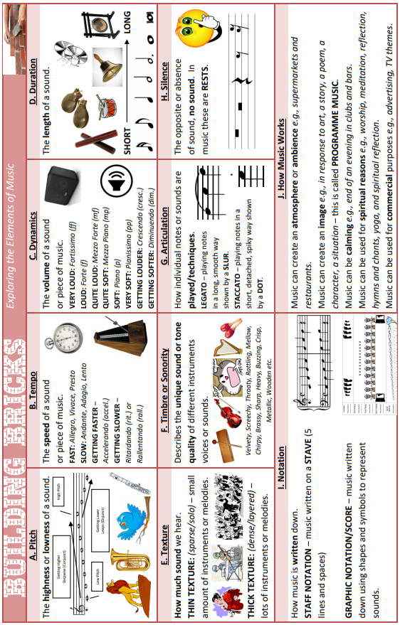
100% Sheet

Slide 4
Icons
Activating prior knowledge
Remember what you already know about a topic before you start to learn something new, to help build connections in your long-term memory.
Retrieval practice
Quizzing, recall and memory activities to slow down the rate of forgetting!
New knowledge
Learn something new through reading, teacher explanation, diagrams, listening to or watching something.
Processing knowledge
Do something with your new knowledge to help you understand it better.
Guided practice
Work collaboratively with your teacher as you strengthen new skills.
Independent practice
Using your knowledge and understanding to complete a piece of quality work independently.
Reflect and respond
Thinking about what you have learned, what went well and what you could improve next time.

Slide 5
Topic Overview: The Elements of Music
What is this topic about?
This topic is designed to introduce students to the very foundations of all music and to begin developing your skills including: Listening and Appraisal of music, composition, improvisation and collaborative music creation and performance.
You look in depth at the selected elements of Pitch, Melody, Dynamics, Duration, Rhythm, Tempo and Silence and learn of the other elements that you will study in more depth in other topics later on in the year. You will be introduced to Graphic Scores and some basic music notation.
You will be introduced to pieces from various different composers and modern artists that will help you train your ears to analyse what the elements of music are doing within each piece.
Link to the GCSE:
At the end of Y11, GCSE students will sit a listening exam where they will hear various pieces of music and will be asked to answer questions based on the elements of music.
Why is this topic important?
The elements of music are fundamental to all music and as such there will not be a single topic that you will study in music that will not refer to them, use them, or require you to know what they are and be able to use them or identify them correctly.
A firm understanding of the elements of music is a key skill for any musician wishing to succeed in the industry. Developing collaborative skills is beneficial for all areas of work and life as it teaches us how to work with others.
How will you be assessed in this topic?
You will be assessed with an initial baseline test to test your basic musical skills/knowledge. You will be assessed on how well you interpret a graphic score and use the elements of music in a creative performance task.

Slide 6
Glossary
Word | Definition
Melody | A Collection of Pitches Creatively Ordered
Articulation | Different Playing Techniques that Produces Different Musical Effects
Dynamics | How Loud or Quiet/Soft the Sound is
Tempo | The Speed of the Music/Sound
Structure | How the Music is Ordered
Harmony | Ordered Pitches/Melodies that are Played at the Same Time
Instruments | The Various Musical Objects we use to Produce Sound/Music
Rhythm | A Pattern of Sounds of Different Lengths
Texture | The Amount of Layers the Music has e.g. The amount of Instruments or Different Melodies
Timbre | The Quality of the Sound e.g. Hollow, Metallic, Smooth
Tonality | The Character of the Music Determined by the Key that can determine the overall emotional effect of the music e.g. Major = Happy, minor = Sad
Pitch | How High or Low a Sound is
Graphic Score | A Representation of Music through the use of Shapes & Symbols

Slide 7
E
L
O
D
Y
R
T
I
C
U
L
A
T
I
O
N
Y
N
A
M
I
C
S
E
M
P
O
T
R
U
C
T
U
R
E
A
R
M
O
N
Y
&
T
O
N
A
L
I
T
Y
N
S
T
R
U
M
E
N
T
S
&
T
I
M
B
R
E
H
Y
T
H
M
&
M
E
T
R
E
E
X
T
U
R
E

Slide 8
Do Now: Brain Dump all the elements of music you can remember and define them
Elements of Music

Slide 9
Do Now: Test your knowledge on the Elements of Music
What element is a ‘Pattern of Sounds of Different Lengths’?
_____________________________
2) What element is an ordered pattern of pitches (also known as a ‘Tune’?
_____________________________
3) What does ‘Tempo’ mean?
_____________________________
4) What are Dynamics?
_____________________________

Slide 10
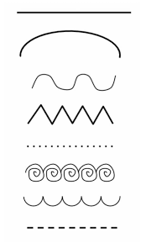
Do Now: Describe how you would sing or play each of these lines (be specific on which elements of music you would use and explain your choices)
1
___________________________________
___________________________________
___________________________________
___________________________________
___________________________________
___________________________________
___________________________________
___________________________________
___________________________________
___________________________________
___________________________________
___________________________________
___________________________________
___________________________________
___________________________________
___________________________________
___________________________________
___________________________________
___________________________________
___________________________________
___________________________________
___________________________________
___________________________________
___________________________________
2
3
4
5
6
7
Elements to Consider:
Pitch, Tempo, Dynamics, Rhythm, Timbre, Instruments

Slide 11
Do Now: Brain Dump all the elements of music you can remember and define them
Elements of Music

Slide 12
Do Now: Draw a picture in the colour coded boxes to represent the different Elements of music that start with each colour coded letter of MAD TSHIRT
THE ELEMENTS OF MUSIC

Slide 13
Homework: create a fact file/poster on the Elements of Music
Stick Fact File here

Slide 14
Homework: create a graphic score that uses at least 2 elements of music (you can use words, pictures, shapes or any other appropriate method to show changing elements of music

Slide 15
Whole class feedback response:
I performed well in ………
I know this because ……..
I need to improve ……..
I will do this by ………
The benefit to me of this would be …….

Slide 16
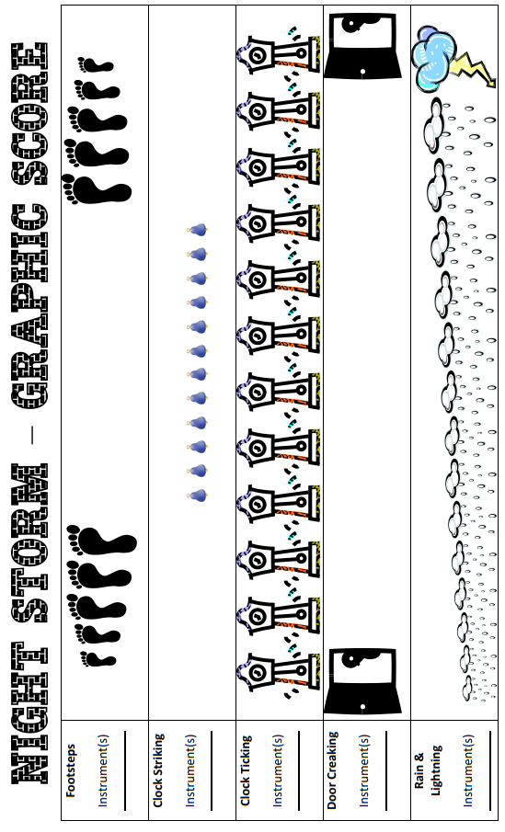
Appendix A1: Graphic Score 1 – Night Storm

Slide 17
Appendix A2: Graphic Score 2
1
Tick Tock
Tick
Tick Tock
Tock
Tick Tock
2
3
Elements to Focus On: Duration, Rhythm, Dynamics, Pitch

Slide 18
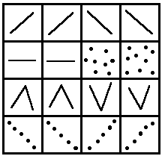
Appendix A3: Graphic Score 3

Slide 19
Additional Space
……………………………………………………………………………………………………………………………............................
……………………………………………………………………………………………………………………………………………………….
……………………………………………………………………………………………………………………………............................
……………………………………………………………………………………………………………………………………………………….
……………………………………………………………………………………………………………………………............................
……………………………………………………………………………………………………………………………………………………….
……………………………………………………………………………………………………………………………............................
……………………………………………………………………………………………………………………………………………………….
……………………………………………………………………………………………………………………………............................
……………………………………………………………………………………………………………………………………………………….
……………………………………………………………………………………………………………………………............................
……………………………………………………………………………………………………………………………………………………….
……………………………………………………………………………………………………………………………............................
……………………………………………………………………………………………………………………………………………………….
……………………………………………………………………………………………………………………………............................
……………………………………………………………………………………………………………………………………………………….
……………………………………………………………………………………………………………………………............................
……………………………………………………………………………………………………………………………………………………….
……………………………………………………………………………………………………………………………............................
……………………………………………………………………………………………………………………………………………………….

Slide 20
……………………………………………………………………………………………………………………………............................
……………………………………………………………………………………………………………………………………………………….
……………………………………………………………………………………………………………………………............................
……………………………………………………………………………………………………………………………………………………….
……………………………………………………………………………………………………………………………............................
……………………………………………………………………………………………………………………………………………………….
……………………………………………………………………………………………………………………………............................
……………………………………………………………………………………………………………………………………………………….
……………………………………………………………………………………………………………………………............................
……………………………………………………………………………………………………………………………………………………….
……………………………………………………………………………………………………………………………............................
……………………………………………………………………………………………………………………………………………………….
……………………………………………………………………………………………………………………………............................
……………………………………………………………………………………………………………………………………………………….
……………………………………………………………………………………………………………………………............................
……………………………………………………………………………………………………………………………………………………….
……………………………………………………………………………………………………………………………............................
……………………………………………………………………………………………………………………………………………………….
……………………………………………………………………………………………………………………………............................
……………………………………………………………………………………………………………………………………………………….

Slide 21
……………………………………………………………………………………………………………………………............................
……………………………………………………………………………………………………………………………………………………….
……………………………………………………………………………………………………………………………............................
……………………………………………………………………………………………………………………………………………………….
……………………………………………………………………………………………………………………………............................
……………………………………………………………………………………………………………………………………………………….
……………………………………………………………………………………………………………………………............................
……………………………………………………………………………………………………………………………………………………….
……………………………………………………………………………………………………………………………............................
……………………………………………………………………………………………………………………………………………………….
……………………………………………………………………………………………………………………………............................
……………………………………………………………………………………………………………………………………………………….
……………………………………………………………………………………………………………………………............................
……………………………………………………………………………………………………………………………………………………….
……………………………………………………………………………………………………………………………............................
……………………………………………………………………………………………………………………………………………………….
……………………………………………………………………………………………………………………………............................
……………………………………………………………………………………………………………………………………………………….
……………………………………………………………………………………………………………………………............................
……………………………………………………………………………………………………………………………………………………….

Slide 22
……………………………………………………………………………………………………………………………............................
……………………………………………………………………………………………………………………………………………………….
……………………………………………………………………………………………………………………………............................
……………………………………………………………………………………………………………………………………………………….
……………………………………………………………………………………………………………………………............................
……………………………………………………………………………………………………………………………………………………….
……………………………………………………………………………………………………………………………............................
……………………………………………………………………………………………………………………………………………………….
……………………………………………………………………………………………………………………………............................
……………………………………………………………………………………………………………………………………………………….
……………………………………………………………………………………………………………………………............................
……………………………………………………………………………………………………………………………………………………….
……………………………………………………………………………………………………………………………............................
……………………………………………………………………………………………………………………………………………………….
……………………………………………………………………………………………………………………………............................
……………………………………………………………………………………………………………………………………………………….
……………………………………………………………………………………………………………………………............................
……………………………………………………………………………………………………………………………………………………….
……………………………………………………………………………………………………………………………............................
……………………………………………………………………………………………………………………………………………………….

Slide 23
……………………………………………………………………………………………………………………………............................
……………………………………………………………………………………………………………………………………………………….
……………………………………………………………………………………………………………………………............................
……………………………………………………………………………………………………………………………………………………….
……………………………………………………………………………………………………………………………............................
……………………………………………………………………………………………………………………………………………………….
……………………………………………………………………………………………………………………………............................
……………………………………………………………………………………………………………………………………………………….
……………………………………………………………………………………………………………………………............................
……………………………………………………………………………………………………………………………………………………….
……………………………………………………………………………………………………………………………............................
……………………………………………………………………………………………………………………………………………………….
……………………………………………………………………………………………………………………………............................
……………………………………………………………………………………………………………………………………………………….
……………………………………………………………………………………………………………………………............................
……………………………………………………………………………………………………………………………………………………….
……………………………………………………………………………………………………………………………............................
……………………………………………………………………………………………………………………………………………………….
……………………………………………………………………………………………………………………………............................
……………………………………………………………………………………………………………………………………………………….

