Slide 1
D&T Disneyland Paris Residential January 2024
Parent Information evening with
Miss Pepper & Visit Staff

Slide 2
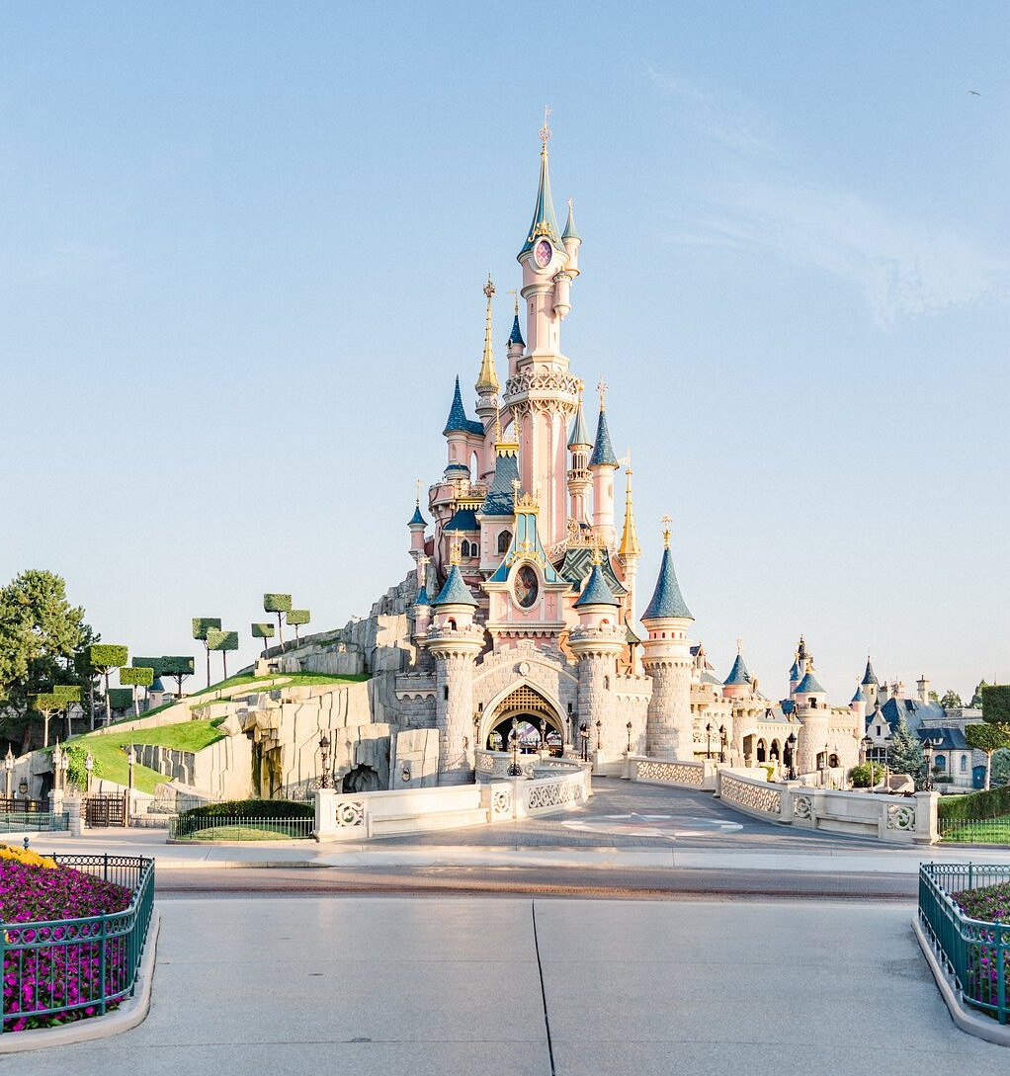
Staff -
Miss Pepper – Group Lead
Mrs Hibbard – First Aider
Mrs Kerry - Head Teacher and Safeguarding Lead
Mrs Miller – Vast amount of trip experience
Mr Parnham – Vast amount of trip experience
Mr Vaughn – First Aider and vast amount of trip experience
The group of staff have been hand picked accordingly
To the needs of the trust’s residential requirements, experience and specialisms.
Notes:
Page 5 in hand out

Slide 3
Hotel Options – Dependant on Numbers/Availability
Grand Magic –
The Grand Magic hotel is situated on park grounds and are a short 5 minute shuttle bus journey (no extra cost) from the park gates; the cost of the shuttle bus is included in the trip’s price so no additional cost will be charged for this.
Hotel rooms will be allocated two/three students of the same sex per room which has now been done by Miss Pepper – if you're unsure who you are sharring with please stay behind at the end and ask :)
Grand Magic Hotel
Notes:
Welcome to the Grand Magic Hotel at Disneyland Paris in Marne La Vallée (grand-magic-hotel.com)
Swimming things may be needed dependant on the hotel we choose to stay at as we may offer students a chance to relax one evening in the pool back at the hotel before tea/bed etc.

Slide 4
Schedule – What will the trip include?
Day 1 - Tuesday 23rd January
Coach will leave Manor Academy at 2:15 AM on the 23rd of January 2024. Therefore, students will need to be dropped off at the latest 1:45AM in the school car park.
Crossing from Dover to Calais on the Ferry is at 10:05AM via P&O Ferries.
Estimated arrival time in Calais is 12:35 PM (local time)
Coach drive to the Grand Magic Hotel with an expected arrival time of 17:35 PM (local time)
Evening Meal is booked in the hotel and is an all you can eat style buffet for 19:30PM (local time.) and is an additional cost.
Please note France are 1 hour in front of us in the UK.
Top Tips for Travel -
Bring plenty of snacks/water.
A blanket/hoody.
Something to keep you entertained, book, Ipad, headphones, switch etc. - whatever electronic devices students do bring are their own responsibility.
Notes:
Page 5 in hand out

Slide 5
Schedule – What will the trip include?
Day 2 – Wednesday 24th January
Breakfast - (Whole Group) will be served at the hotel and is included in the price paid for the trip – this will be buffet style once again, so students can eat as much or as little as they wish!
Full Park Day – (Individual Groups) Students will be in the Disney Land Park for the full day – groupings of Staff and students will be arranged prior to the trip e.g. 9 per staff member; 18 per 2. 1 member of staff will be situated in a designated area at all times (staff member/place may change, but this will be communicated with the students in the individual groups).
Evening Meal – (Whole Group) Booked at The Royal Pub in Disney Village – this will be an all you can eat buffet style/ 1 main/ 1 Drink/1 Side/1 Dessert set up and is an additional cost. Time to be confirmed.
Fireworks and Drone Show - (Whole Group) - After the evening meal students and staff will return to the Disney Land Paris park (short 5 min walk) and watch the fireworks and drone show on Mainstreet – The coach will pick us up from the park and take us back to the hotel once finished.
Top Tips for the Parks -
Bring plenty of snacks/water.
LAYERS – it will be between 3 and 8 degrees when we're there on average and rains every other day/snow can be expected!
Wear sensible footwear - it's a LOT of walking!
Download the Disney Land Paris APP before you go!
Notes:
Page 5 in hand out

Slide 6
Schedule – What will the trip include?
Day 3 - Thursday 25th January
Breakfast - (Whole Group) will be served at the hotel; will have a later start/entry to the parks after a full day day 2, this is included in the price paid for the trip – this will be buffet style once again, so students can eat as much or as little as they wish!
S
Semi - Park Day – (Individual Groups) Students will be in the Walt Disney Studio's Park for the full day – groupings of Staff and students will be arranged prior to the trip e.g. 9 per staff member; 18 per 2. 1 member of staff will be situated in a designated area at all times (staff member/place may change, but this will be communicated with the students in the individual groups). Animation Drawing Sessions and Shows will be booked and discussed with students for times etc.
Seminar & Workshop – (Whole Group) - We will leave the park at 17:00 for their D&T seminar at 17:30 followed by their workshop at 18:45.
Evening Meal – (Whole Group) A buffet style sit down meal at either the Grand Magic Hotel or Hotel Cheyenne at 8PM – students will be reminded to have a later lunch this day, this will be an additional cost.
Top Tips for the Parks -
Bring plenty of snacks/water.
LAYERS – it will be between 3 and 8 degrees when we're there on average and rains every other day/snow can be expected!
Wear sensible footwear - it's a LOT of walking!
Download the Disney Land Paris APP before you go!
Notes:
Page 5 in hand out

Slide 7
Schedule – What will the trip include?
Day 4 – Friday 26th January
Coach will leave The Grand Magic after breakfast via coach.
Crossing from Calais to Dover on the Ferry is at 15:00PM (local time) via P&O Ferries.
Estimated arrival time back at Manor Academy is between 21:30 and 22:00 Local time – teachers will ensure students update parents/careers who are picking them up from the school if anything changes etc.
Students will be encouraged to fill up on breakfast and ensure to save some snacks for the journey back – food will be available at services stations and on the ferry at an additional cost.
Please note France are 1 hour in front of us in the UK.
Top Tips for Travel -
Bring plenty of snacks/water.
A blanket/hoody.
Something to keep you entertained, book, Ipad, headphones, switch etc. - whatever electronic devices students do bring are their own responsibility.
Notes:
Page 5 in hand out

Slide 8
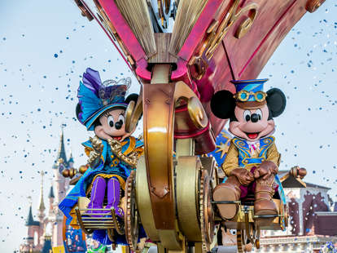
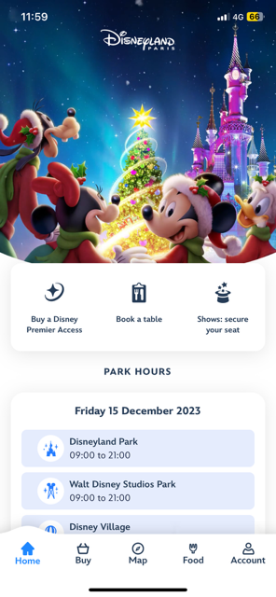
Requirements for the trip -
What you MUST bring/do
Passport - I am still waiting on 3 peoples passports details – without this you won’t be able to travel.
GHIC Card - These are free and you can apply for them here; Applying for healthcare cover abroad (GHIC and EHIC) - NHS (www.nhs.uk) These are taking around 3 weeks to arrive so the sooner the better.
Download the Disney Land Paris mobile phone app – this gives students and staff a map of the two parks; attraction time wait times AND directions where they can select the meeting place and the app will physically direct them there through the park.
Suitcases - The coach/travel company have specifically stated students should bring a small/medium suitcase for the trip to enable enough space for all travelers luggage to be stored underneath – backpack/pillow/oodie can be brought on board with them.
Notes:
Students withing current YR 9 will ONLY be given a place if D&T is chosen as one of their GCSE options due to the nature of the trip; this will also be the same for YR 8’s.

Slide 9
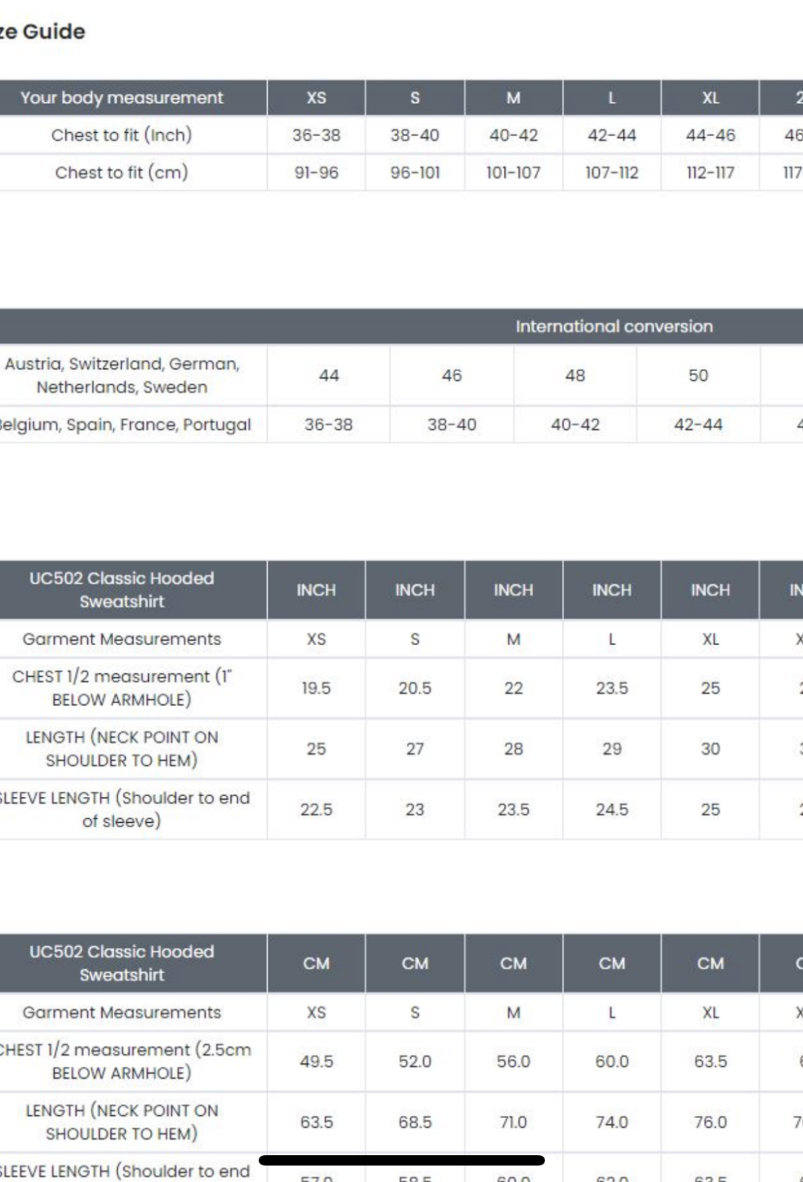
Hoodies -
*Each student is required to have a DLP 2024 hoodie – this is so as we can easily spot them at service stations, ferry etc when there is a big group of people.
* This has been built into the risk assessment and is a requirement for all to wear at stated times.
* Hoodies are £25.99 – please let Mrs Pepper or Mrs Hibbard know what size you require ASAP. These will be available in S,M,L Adult sizes.
Notes:
Students withing current YR 9 will ONLY be given a place if D&T is chosen as one of their GCSE options due to the nature of the trip; this will also be the same for YR 8’s.

Slide 10
Safety –
Due to the nature of the trip, safety is paramount for both staff and students, therefore the following procedures are in place so that this can be adhered to;
Expectations of student’s behaviour on the trip will be the same as expected on the school site if not higher as they will be representing the school abroad; any problems surrounding behaviour will be dealt with on return to school after the residential.
Students will be registered throughout the trip with a selected teacher; students will be allocated a teacher who will be there “go to” person throughout the trip; contact information of their teacher will be given to the students if they need to make contact whilst on the trip.
A member of staff on the trip will be both First Aid and Safe-Guarding trained in the instance that an event should occur that we should need someone within either of these areas.
Travel insurance is provided by the travel company; however, it is advised that all students have
an EHIC/GHIC card in the instance of health care needing to be paid for in France – these are
free and can be applied for on the Gov website.

Slide 11
D&T Disneyland Paris Residential January 2024
Questions?

