Slide 1
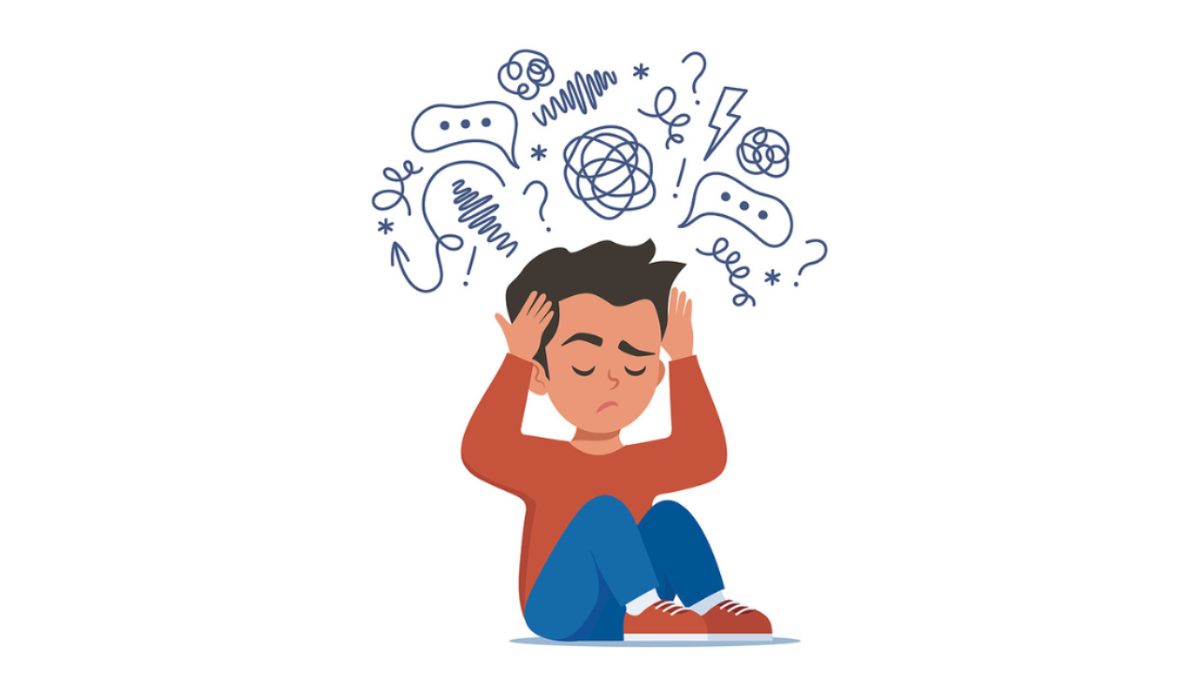
Honesty x Health and Wellbeing: Resilience Manor Mental Health First Aid Ambassador

Slide 2
Manor Mental Health First Aid Ambassador
What is it about?
Ever wanted to make a real difference in your friends' and family's lives? By becoming a Manor Mental Health First Aid Ambassador, you can do just that! This award is for those who want to learn how to support others, understand mental health issues, and spread positivity. It's your chance to be a hero, offering a helping hand and a listening ear. Join us in this amazing initiative and be the person everyone can rely on. Let’s create a supportive and caring community together!
Why is this important?
This initiative is important for several reasons:
Supporting Others: Many people face mental health challenges but may not know how to seek help or have someone to turn to. Becoming a Manor Mental Health First Aid Ambassador equips you with skills to support others effectively, offering practical assistance and emotional support when it's needed most.
Understanding Mental Health: There is still a stigma surrounding mental health issues in many communities. By learning about mental health issues and how to address them sensitively, ambassadors can help break down barriers and promote understanding and empathy.
Spreading Positivity: Mental health first aid isn't just about responding to crises; it's also about promoting positive mental well-being. Ambassadors can actively contribute to creating a more positive and supportive environment for friends, family, and the broader community.
Being a Hero: The role of a mental health first aid ambassador positions you as someone who can make a real difference in people's lives. Being there as a listener and a source of practical support can significantly impact someone's recovery and well-being.
Building a Supportive Community: By encouraging others to join this initiative, you contribute to building a community where mental health is prioritized and where everyone feels supported and understood. This sense of community can be invaluable in fostering resilience and improving overall mental health outcomes.
In summary, becoming a Manor Mental Health First Aid Ambassador allows individuals to contribute positively to their community by providing support, understanding, and advocacy for mental health issues. It empowers individuals to make a tangible difference in the lives of those around them, creating a more compassionate and caring environment overall.
How will you be assessed?
After you complete the booklet there will be an online quiz

Slide 3
Contents
Part 1: Understanding Mental Health
Part 2: Introduction to ALGEE
Part 3: Assess for Risk of Suicide or Self Harm
Part 4: Listen Non-Judgmentally
Part 5: Give Reassurance and Information
Part 6: Encourage Appropriate Professional Help
Part 7: Encourage Self-Help and Other Support Strategies
Part 8: Practice Applying the ALGEE Action Plan in Various Situations

Slide 4
Part 1: Understanding Mental Health
What is Mental Health?
Definition and Importance of Mental Health
Mental health is about our feelings, thoughts, and how we interact with others. It affects how we handle stress, relate to people, and make choices. Good mental health helps us enjoy life and deal with challenges.
Definition: Mental health is being in a good state where you feel good about yourself, can handle daily stresses, work well, and contribute to your community.
Importance: It’s important because it helps you:
Reach your potential
Handle life's pressures
Work effectively
Contribute positively to society
Jo is a 33-year-old Doctor. Explain why having good mental health would be important to them. <hint: Because it…. Therefore… as a consequence…
Common Mental Health Issues Among Young People
Young people can face various mental health challenges. Here are some common ones:
Anxiety: Feeling very worried or scared about things.
Depression: Feeling very sad and losing interest in activities you used to enjoy.
ADHD: Having trouble paying attention, staying still, or being impulsive.
Eating Disorders: Issues with eating, like eating too little or too much.
Substance Abuse: Misusing drugs or alcohol.
Self-Harm and Suicidal Thoughts: Hurting yourself or thinking about ending your life.
What reasons are there to explain why some of these are high amongst young people. <hint: Because…

Slide 5
Role of a Mental Health First Aider
Responsibilities and Boundaries
A Mental Health First Aider (MHFA) is someone trained to help people with mental health issues. They aren’t therapists but are there for initial support.
Responsibilities:
Recognize: Spot signs of mental health issues.
Approach: Talk to the person in a caring way.
Listen: Hear them out without judging or giving advice.
Support: Provide comfort and information on where to get help.
Encourage: Motivate them to seek professional help.
Boundaries:
Know Your Role: Remember you’re not a professional therapist.
Confidentiality: Keep things private but know when to tell someone if the person is in danger.
Self-Awareness: Know your limits and don’t get too involved.
Choose one boundary. Explain why having that boundary is so important. <hint: Because it…. Therefore… as a consequence…
Importance of Self-Care for First Aiders
Mental Health First Aiders need to take care of themselves to avoid getting stressed or burned out.
Self-Care Tips:
Take Breaks: Rest and recharge regularly.
Talk to Peers: Share your experiences with other first aiders.
Seek Help: Get professional support if you’re feeling overwhelmed.
Live Healthily: Eat well, exercise, and get enough sleep.
Relax: Practice mindfulness or relaxation techniques to reduce stress.
By understanding mental health and the role of a Mental Health First Aider, you can help others while also taking care of yourself.
Which do you think is the most useful self-care tip and why?

Slide 6
Part 2: Introduction to ALGEE
Overview of the ALGEE Action Plan
The ALGEE Action Plan is a simple guide for helping someone experiencing a mental health problem. Each letter in ALGEE stands for a different step:
A - Assess for risk of harm
L - Listen non-judgmentally
G - Give reassurance and information
E - Encourage appropriate professional help
E - Encourage self-help and other support strategies
Let's break down each step.
Assess for Risk of Harm
What it means: Check if the person is in immediate danger of hurting themselves or others.
Importance: This is the first and most crucial step. If someone is in immediate danger, they need urgent help.
Listen Non-Judgmentally
What it means: Let the person talk about what they are going through. Don’t judge or interrupt them.
Importance: People need to feel heard and understood. Listening can help them feel supported and less alone.
Give Reassurance and Information
What it means: Comfort the person and provide information about mental health and where to get help.
Importance: Reassurance can calm the person and give them hope. Accurate information helps them understand their situation better.
Encourage Appropriate Professional Help
What it means: Suggest they seek help from professionals like doctors, therapists, or counsellors.
Importance: Professional help is often necessary for dealing with mental health issues effectively.
Encourage Self-Help and Other Support Strategies
What it means: Motivate them to engage in activities and practices that support their well-being, such as exercise, hobbies, or support groups.
Importance: Self-help and support networks are crucial for long-term mental health. They help the person manage their condition and feel more in control.
Andi is 14-years-old. They are experiencing difficulties with their mental health. Using ALGEE explain what you think the consequence will be of following each step
If I do this…
If I do this…
If I do this…
If I do this…
If I do this…

Slide 7
Part 3: Assess for Risk of Suicide or Self Harm
This can be a very difficult section. If you are struggling with any of it, speak to a trusted adult straight away.
Recognizing Warning Signs
Understanding and recognizing warning signs is critical in assessing if someone is at risk of suicide or harm.
Physical Signs:
Changes in sleep patterns (sleeping too much or too little)
Lack of energy or always feeling tired
Noticeable changes in weight or appetite
Physical neglect of personal appearance
Emotional Signs:
Persistent sadness or depression
Extreme mood swings
Feelings of hopelessness or worthlessness
Sudden calmness after a period of depression
Behavioural Signs:
Withdrawal from friends, family, and activities
Giving away prized possessions
Increased use of alcohol or drugs
Talking about death or suicide
Engaging in risky or self-destructive behaviours
Which, out of physical, emotional and behavioural, would be easiest to notice?
Hinge Question 1: How can recognizing changes in sleep patterns, energy levels, and appetite help in identifying someone at risk of suicide or self-harm?
A) It indicates they may have a physical illness.
B) It suggests they are experiencing a normal reaction to stress.
C) It provides clues about their emotional state and potential risk.
D) It indicates they are not getting enough exercise.
Hinge Question 2: Why is it important to pay attention to sudden shifts in mood, withdrawal from usual activities, and increased substance use when assessing someone's risk of suicide or self-harm?
A) It suggests they are simply going through a phase.
B) It indicates they are becoming more independent.
C) It may signify underlying mental health concerns and potential risk.
D) It shows they are seeking attention.

Slide 8
Immediate Risks vs. Non-Immediate Risks
Immediate Risks:
Person has a specific plan for suicide
Talking about wanting to die or actively seeking means to harm themselves
Displaying severe mood swings or rage
Non-Immediate Risks:
Expressing feelings of hopelessness or having no reason to live
Saying they feel trapped or in unbearable pain
Talking about being a burden to others
Why is it important to distinguish between immediate risks and non-immediate risks when assessing someone's potential for suicide or self-harm?<hint: Because it…. Therefore… as a consequence…
Appropriate Actions
How to Approach the Person:
Approach them in a private and safe space
Speak calmly and clearly
Show genuine concern and compassion
Ask open-ended questions like “How are you feeling?”
Ensuring Safety and Seeking Immediate Help if Necessary:
If the person is in immediate danger, do not leave them alone
Call emergency services or a crisis hotline
Remove any means of self-harm if it’s safe to do so
Stay with them until professional help arrives
How would you feel in this situation?

Slide 9
Part 4: Listen Non-Judgmentally
Active Listening Skills
Listening non-judgmentally involves giving the person your full attention and showing that you care.
Techniques for Effective Listening:
Eye Contact: Maintain appropriate eye contact to show you’re engaged.
Body Language: Use open and relaxed body language.
Nodding: Show you’re following along.
Paraphrasing: Repeat what they’ve said in your own words to show understanding.
Questions: Ask questions to clarify and show interest but avoid interrupting.
Creating a Safe and Supportive Environment:
Privacy: Ensure conversations are private and free from interruptions.
Empathy: Show empathy by validating their feelings (e.g., “That sounds really tough.”).
Non-Judgmental Attitude: Avoid judging or giving advice, simply listen and support.
Reassurance: Let them know it’s okay to talk about their feelings.
Common Barriers to Listening
Distractions: External noises, interruptions, or thinking about what to say next can interfere with listening.
Judgment: Having preconceived notions or judgments about the person or their situation.
Advice-Giving: Wanting to jump in with solutions instead of just listening.
Emotional Reactions: Feeling overwhelmed by what the person is sharing.
How to Overcome Them
Minimize Distractions: Find a quiet place to talk and put away your phone.
Stay Open-Minded: Remind yourself to listen without judging.
Hold Back Advice: Focus on listening and understanding first before offering advice.
Manage Your Emotions: Take deep breaths and stay calm, seek support for yourself if needed.
By effectively assessing for risk and listening non-judgmentally, you can provide crucial support to those experiencing mental health challenges.
Choosing one from each section above what advice would you give to listen actively and non-judgmentally? <hint: You should… because… however… you should

Slide 10
Part 5: Give Reassurance and Information
Providing Support
Offering Emotional Support
Be Present: Show that you care by being there for the person. Sometimes, just being with them can provide comfort.
Use Positive Language: Offer encouraging words. Let them know they are not alone and that you are there to help.
Validate Feelings: Acknowledge their feelings without judgment. For example, say, “It’s okay to feel this way.”
Dispelling Myths and Providing Accurate Information
Myth: "People with mental health issues can just snap out of it."
Truth: Mental health issues are real health conditions that require proper care and support.
Myth: "Talking about mental health will make it worse."
Truth: Open conversations about mental health can help and provide relief.
Provide Facts: Share reliable information about mental health and resources for getting help.
Building Trust
Maintaining Respect
Respect: Treat them with dignity and respect their feelings and experiences.
Follow Through: If you promise to do something to help, make sure you do it. This builds trust.
Pick one and write down what you could say to offer emotional support
Why is important to provide facts? BTA
Why is it important to follow through?

Slide 11
Part 5: Give Reassurance and Information
Providing Support
Offering Emotional Support
Be Present: Show that you care by being there for the person. Sometimes, just being with them can provide comfort.
Use Positive Language: Offer encouraging words. Let them know they are not alone and that you are there to help.
Validate Feelings: Acknowledge their feelings without judgment. For example, say, “It’s okay to feel this way.”
Dispelling Myths and Providing Accurate Information
Myth: "People with mental health issues can just snap out of it."
Truth: Mental health issues are real health conditions that require proper care and support.
Myth: "Talking about mental health will make it worse."
Truth: Open conversations about mental health can help and provide relief.
Provide Facts: Share reliable information about mental health and resources for getting help.
Building Trust
Maintaining Respect
Respect: Treat them with dignity and respect their feelings and experiences.
Follow Through: If you promise to do something to help, make sure you do it. This builds trust.
Pick one and write down what you could say to offer emotional support
Why is important to provide facts? BTA
Why is it important to follow through?

Slide 12
Part 6: Encourage Appropriate Professional Help
Types of Professional Help
Therapists: Provide talk therapy (like CBT or DBT) to help people understand and manage their thoughts and behaviours.
Counsellors: Offer guidance and support for everyday problems and stressors.
Psychiatrists: Medical doctors who can diagnose mental health conditions and prescribe medication.
Psychologists: Professionals who can provide therapy and conduct assessments but generally do not prescribe medication.
Social Workers: Help connect individuals with community resources and support services.
How to Encourage Seeking Help
Ways to Suggest Professional Help Without Being Forceful
Be Supportive: Use phrases like, “I think it could really help to talk to someone who is trained to help with this.”
Share Personal Experiences: If appropriate, share a story about someone (or yourself) who benefited from professional help.
Provide Options: Offer information about different types of help available and let them choose what feels right for them.
Providing Resources and Information on How to Access Help
Local Resources: Provide information about local mental health clinics, hotlines, and support groups.
Online Resources: Share websites and online therapy options.
Crisis Lines: Ensure they have numbers for crisis hotlines, like the Childline
By giving reassurance and information, and encouraging appropriate professional help, you can guide someone toward the support they need while making them feel understood and respected.
You think that Jamie should seek appropriate professional help. What would you say to engage them to go?

Slide 13
Part 7: Encourage Self-Help and Other Support Strategies
Self-Help Strategies
Healthy Lifestyle Choices
Exercise: Regular physical activity can boost mood and energy levels.
Nutrition: Eating a balanced diet helps maintain physical and mental health.
Sleep: Getting enough sleep is crucial for mental well-being.
Relaxation Techniques
Mindfulness and Meditation: Practices that help calm the mind and reduce stress.
Deep Breathing: Simple exercises to manage anxiety and stress.
Yoga: Combines physical postures, breathing exercises, and meditation.
Stress Management
Time Management: Prioritising tasks and managing time effectively can reduce stress.
Hobbies: Engaging in activities you enjoy can be a great way to relax.
Journaling: Writing about your feelings and experiences can help process emotions.
Peer Support
Benefits of Support Groups and Talking to Friends or Family
Support Groups: Provide a sense of community and understanding.
Talking to Friends/Family: Sharing feelings with trusted individuals can provide comfort and advice.
Online Communities: Virtual support groups can also offer connection and support.
Explain how three of the above may help

Slide 14
Practice Applying the ALGEE Action Plan in Various Situations
Scenario 1: A friend is feeling overwhelmed by schoolwork and mentions feeling hopeless.
Practice: Approach the friend, listen non-judgementally, and encourage them to seek help.
Characters:
Alex: The friend who is feeling overwhelmed by schoolwork.
Jamie: The supportive friend who uses the ALGEE method.
Setting:
A quiet corner of a university library, with books and laptops scattered around. Alex looks stressed, while Jamie approaches with concern.
Jamie: (Approaches Alex and sits down beside them) Hey Alex, I've noticed you seem pretty stressed lately. Is everything alright? (A - Approach, assess, and assist)
Alex: (sighs deeply) Hey Jamie. I just feel so overwhelmed with all this schoolwork. It's like no matter how hard I try, I can't keep up. I feel hopeless.
Jamie: I'm really sorry you're feeling this way. School can be incredibly tough sometimes. Do you want to talk more about what's been going on? (L - Listen non-judgmentally)
Alex: I have this huge project due next week, three exams coming up, and on top of that, I still have regular homework. It feels like there's no end to it, and I just can't see how I'm going to get through it all.
Jamie: That sounds really intense and overwhelming. It's completely okay to feel this way. I'm here for you, and we can figure this out together. (L - Listen non-judgmentally)
Alex: (rubbing their temples) Thanks, Jamie. I just don't know where to start or how to deal with all this.
Jamie: It sounds like you have a lot on your plate. Have you considered talking to a counsellor or a mental health professional? They can offer support and strategies for managing stress. (G - Give reassurance and information)
Alex: I haven’t really thought about that. I guess I’ve been too caught up in everything.
Jamie: It can be really helpful. Also, taking breaks and self-care are important, even when you’re busy. It might help to organize your tasks into smaller, more manageable steps. We can work on a plan together if you’d like. (G - Give reassurance and information)
Alex: (nodding) That might be a good idea. I just need to get a handle on all this.
Jamie: Let's start by listing everything you need to do, and then we can prioritize and tackle one thing at a time. And it's okay to ask for help, whether from friends, professors, or professionals. You're not alone in this. (E - Encourage appropriate professional help)
Alex: (looking slightly hopeful) Yeah, maybe that would help.
Jamie: Definitely. And I can study with you or just be there when you need a break. Also, maybe we can find some on-campus resources together, like a study group or a tutoring centre. (E - Encourage appropriate professional help)
Alex: (smiling slightly) Thanks, Jamie. I really appreciate you being here and helping me through this.
Jamie: Anytime, Alex. Let's work on that list and take it one step at a time. And remember, it’s okay to reach out for help whenever you need it. (E - Encourage self-help and other support strategies)

Slide 15
Practice Applying the ALGEE Action Plan in Various Situations
Identify the ALGEE strategy
Scenario 2: A peer is withdrawing from social activities and seems unusually sad.
Practice: Recognise signs of depression, offer support, and suggest professional help.
Characters:
Taylor: The peer who is withdrawing from social activities and seems unusually sad.
Jordan: The supportive peer who uses the ALGEE method.
Setting:
A common area in the dormitory, where students usually hang out. Taylor is sitting alone, looking sad and withdrawn. Jordan approaches with concern.
Jordan: (Approaches Taylor and sits down beside them) Hey Taylor, I’ve noticed you haven’t been around much lately. You seem a bit down. Is everything alright? (
Taylor: (sighs deeply) Oh, hey Jordan. I don't know. I just haven’t been feeling like myself lately. I guess I’m just tired.
Jordan: I'm really sorry to hear that. Do you want to talk about what's been going on? I’m here to listen.
Taylor: I don’t even know where to start. I just feel so sad all the time, and I don’t have the energy to hang out with anyone anymore. I feel like I’m letting everyone down.
Jordan: That sounds really tough. It’s okay to feel that way, and you’re not letting anyone down. Sometimes we all go through rough patches.
Taylor: (tears up) Thanks, Jordan. I just feel so overwhelmed by everything, and I don’t know what to do.
Jordan: It’s important to take care of yourself. Have you thought about talking to a counsellor or mental health professional? They can offer support and help you find ways to feel better. (G - Give reassurance and information)
Taylor: I’ve been thinking about it, but I don’t know. It feels like admitting defeat.
Jordan: It’s not defeat at all. It’s actually a strong and brave step to take. Getting professional help can make a big difference. And it's just one part of taking care of yourself.
Taylor: (nodding) Maybe you’re right. I just feel so lost.
Jordan: It’s okay to feel that way. We can look into some resources together, if you want. And in the meantime, maybe we can start with small steps, like going for a walk or grabbing a coffee. Sometimes a change of scenery helps.
Taylor: (looking slightly hopeful) Yeah, that might help.
Jordan: Absolutely. Also, remember that it’s okay to reach out to friends for support. We care about you and want to help. Maybe we can find a support group or some activities that you enjoy.
Taylor: (smiling slightly) Thanks, Jordan. I really appreciate you being here and offering to help.
Jordan: Anytime, Taylor. Let’s take it one step at a time. And remember, it’s perfectly okay to ask for help and to take care of yourself. You’re not alone in this.

Slide 16
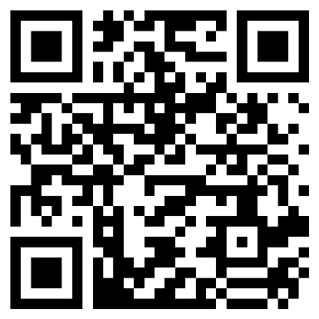
The Quiz!
Congratulations, you have reached the end of the course. Please complete the quiz to check your knowledge:
https://forms.office.com/e/tX1dm3dD1Z
Thank you for taking the time to find out more about supporting others with their mental health.

